Slide 1



Code generation, the good part
PETER VERHAS

Slide 2



AGENDA
W H Y, W H E N, W H A T
EPAM SEC 2019
Why do we generate code?
When to generate code?
What is Java::Geci framework?

Slide 3
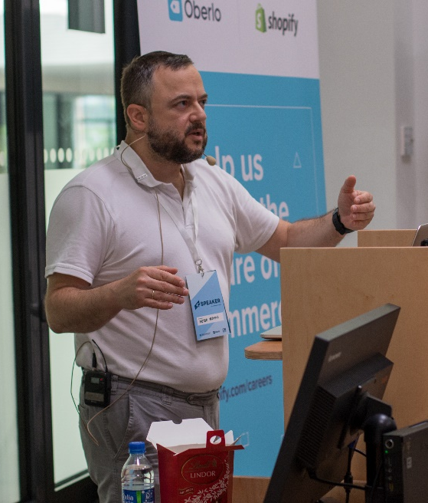

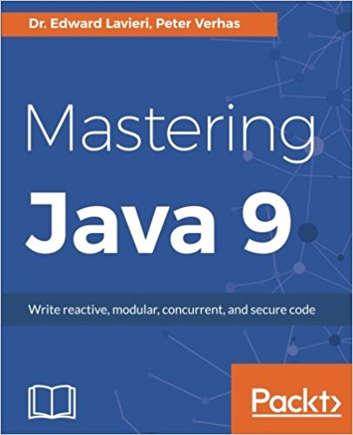

P E T E R V E R H A S
EPAM SYSTEMS, LEAD DEVELOPER
EPAM SEC 2019
Java Senior Architect
Lead Java Software Developer
Java Book Author, Blogger
(top 100 Java Blogs)
Mentor (Swiss Java Architect Academy)
Conference Speaker
(W-JAX, BaselOne, Vilnius DevDays, JavaLand)

Slide 4

Who are we?
EPAM SEC 2019
We are EPAM
We are Engineers
We are the Digital future
We are Java Engineers
We are Java Architects
We are Java Developers

Slide 5

SECTION 1
WHY DO WE GENERATE CODE?

Slide 6

Why do we generate code?
“Something is rotten in the state of Denmark” (Hamlet)
EPAM SEC 2019
C programming language had a preprocessor (Java does not)
Examples:
Yacc, Lex generate code
ANTLR, mapstruct generates Java
IDE -> hashCode, equals, getters, setters
Lombok, Mapstruct
Code generation is fairly common
pictures with the permission of the artist, Máté Verhás © 2018

Slide 7
Why do we generate code?
“Something is rotten in the state of Denmark” (Hamlet)
EPAM SEC 2019
But why?
The language does not support ...
Syntax parser description
Bean field transfer declaration
Getter / Setter, hashCode ... declaration
Anything special
all pictures with the permission of the artist, Máté Verhás © 2018

Slide 8
Why do we generate code?
“Something is rotten in the state of Denmark” (Hamlet)
EPAM SEC 2019
But it is not only the programming language
The programming language is not „good” enough
Framework is not „good” enough
Developer is not good enough
pictures with the permission of the artist, Máté Verhás © 2018

Slide 9

Why do we generate code?
“Something is rotten in the state of Denmark” (Hamlet)
EPAM SEC 2019
Language can not be overbloated
Do you really want Java
to support SOAP directly on language level?
equals, hashCode, setter/getter declarations?
automatic delegation to field?
Framework... Given
Developer... seriously?
The fundamental reason is redundancy.
pictures with the permission of the artist, Máté Verhás © 2018

Slide 10
SECTION 2
CODE REDUNDANCY

Slide 11
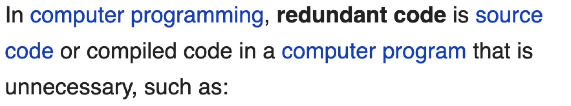
“
https://en.wikipedia.org/wiki/Redundant_code
SAYS
“
”

Slide 12
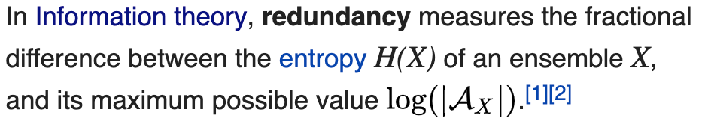
“
https://en.wikipedia.org/wiki/Redundancy_(information_theory)
SAYS
????????
“
”

Slide 13
“
It

Slide 14
“
It can

Slide 15
“
It can be

Slide 16
“
It can be compressed

Slide 17

“
It can be compressed
Huffmann Coding

Slide 18
82%
“
It can be compressed

Slide 19
82%
“
It can be compressed
… it is not the reason

Slide 20
The source code is IT redundant
EPAM SEC 2019
Six Redundancy levels
0. Natural
1. Language
2. Structural
3. Domain induced
4. Language evolution
5. Programmer induced
pictures with the permission of the artist, Máté Verhás © 2018

Slide 21

Redundacy level #0
N A T U R A L
EPAM SEC 2019
Spoken language is redundant
Probably evolution
To compensate channel noise
Photo by Federico Giampieri on Unsplash
Notes:
TYPO in the title is intended to demonstrate communication redundancy

Slide 22

Redundancy level #1
L A N G U A G E
EPAM SEC 2019
Declarations, long names
Redundancy is good, it helps avoid mistakes
Corrects noise of the source (the programmers brain)
Photo by Robina Weermeijer on Unsplash

Slide 23

Redundancy level #2
S T R U CT U R A L
EPAM SEC 2019
This redundancy comes from the program structure
e.g.: change in method signature has to be followed by method calls change.
Photo by CloudVisual on Unsplash

Slide 24
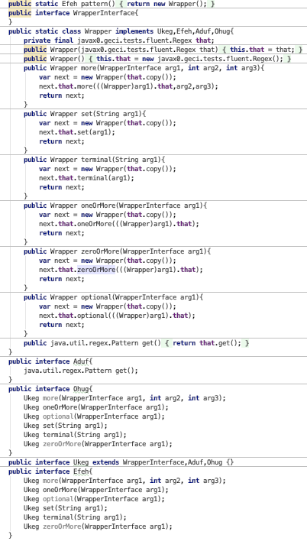
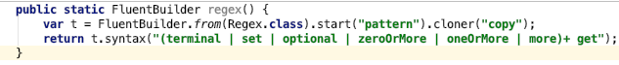
Redundancy level #3
D O M A I N I N D U C E D
EPAM SEC 2019
Domain is complex and needs special DSL
Example: fluent API
all pictures with the permission of the artist, Máté Verhás © 2018

Slide 25

Redundancy level #4
L A N G U A G E E V O L U T I O N
EPAM SEC 2019
Example
Anonymous class -> lambda
Photo by Johannes Plenio on Unsplash

Slide 26



Redundancy level #5
P R O G R A M M E R
EPAM SEC 2019
Classic redundancy,
Code duplicate
Copy / Paste
Twin code fragments
Photo by Bùi Thanh Tâm, Aaron Burden, Parker WhitsonPhoto, on Unsplash

Slide 27
3 and 4 an be approached using code generation
EPAM SEC 2019
Redundancy levels
0. Natural
1. Language
2. Structural
3. Domain induced
4. Language evolution
5. Programmer induced
pictures with the permission of the artist, Máté Verhás © 2018

Slide 28
Code generator examples
EPAM SEC 2019
Redundancy levels
0. Natural
1. Language
2. Structural
3. Domain induced
4. Language evolution
5. Programmer induced
IDE -> hashCode, equals
Lombok
pictures with the permission of the artist, Máté Verhás © 2018

Slide 29
Code generator examples
EPAM SEC 2019
Redundancy levels
0. Natural
1. Language
2. Structural
3. Domain induced
4. Language evolution
5. Programmer induced
ANTLR, MapStruct, Java::Geci
pictures with the permission of the artist, Máté Verhás © 2018

Slide 30
SECTION 3
WHEN TO GENERATE CODE / Java::Geci

Slide 31
Development phases
EPAM SEC 2019

Slide 32
Which phase to generate code
EPAM SEC 2019

Slide 33
Why generate code in test phase?
EPAM SEC 2019
+
-
Easy to create new generators
Reflection API is well knows
Access text as well as compiled code
Generated code gets into CVS
Tad late: code was already compiled
Needs double compilation if code changed
Unusual
Generated code gets into CVS

Slide 34
Development phases/ 2
EPAM SEC 2019

Slide 35
Development phases/ 2
EPAM SEC 2019

Slide 36
Development phaseswith Java::Geci
EPAM SEC 2019
4.
2.
1.
Compile
Run code generating test
If code was generated, modified then fail the test
Compile again

Slide 37


How did we get the idea?
EPAM SEC 2019
This is an unusual flow
The original idea was to check document consistency
The version number in the documentation is the same as in the pom.xml
If it is not then we can update it automatically
Wait… this is document generation
Could it be used for code generation?
Photo by Júnior Ferreira on Unsplash

Slide 38

Java::Geci in a nutshell (or coffe bean)
EPAM SEC 2019
I D E A S
Create a framework for the common tasks
Provide lovable API for the code generator classes
A V A I L A B L E
Framework (1.2.0 release)
Ready generators
Setter/getter, delegator, equals, hashCode, cloner
Fluent API generator
Document generator
F U T U R E
Use in FOSS projects, e.g. Apache Commons Lang
More generators
Photo by Jonas Weckschmied on Unsplash

Slide 39

Summary Takeaway
EPAM SEC 2019
Redundancy is not always bad
Do not be afraid to generate code
Use professional tools
Use Java::Geci to create your own generators
this is professional… like EPAM
Photo by Jon Tyson on Unsplash

